Slide 1

Welcome alex
Kent State University
New Hire Orientation
Benefits & Wellness
Program
http://www.kent.edu/hr/benefits/new-hire-benefits-information
1 of 61

Slide 2

Employee Wellness
Kim Hauge, Director, Employee Wellness

Slide 3


Kent State of Wellness Priorities
Physical Activity
Nutrition
Mental Health
Sexual Health
Smoking and Tobacco Use
Preventive care
Alcohol & other drug use
Safety

Slide 4

Employee Wellness
Kent State University is committed to supporting employee health and well-being. Throughout the year, KSU offers programs such as:
Monthly Lunch and Learns
Weight Watchers at Work
Walking Challenges
Group Exercise Classes
Health Screening/Health Risk Assessment
To view the calendar, please visit http://www.kent.edu/hr/benefits/wellness
To view the Rewards program, please visit http://www.kent.edu/hr/benefits/wellness-rewards
For more information, contact Kim Hauge, Director, Employee Wellness at 330-672-7505 or via email at wellness@kent.edu.

Slide 5

The Wellness Your Way Employee Incentive Program Seeks to Promote:
Healthy lifestyle choices that align with the Kent State of Wellness priorities
Includes higher point values for preventive care choices (Know Your Numbers, HRA completion, well visits, group and individual challenges, wellness coaching, weight management programs, etc..)
Voluntary participation

Slide 6
How It Works
Tier One (Deadline is June 30)
Complete your Know Your Numbers health screening at the worksite or with your primary care physician (PCP)
Complete your health risk assessment (HRA)
Tier One reward is $150 wellness incentive added to your pay or, if eligible, to your health savings account (HSA)

Slide 7
How It Works (Continued)
Tier Two – Deadline Oct. 15, 2017
Earn a total of 350 points your way – Earn $150
**Points can be earned through a variety of individual or group activities
between Jan. 1 – Oct. 15, 2017. Examples include:
Annual Wellness Visits/Preventive Care
Dental Exam
Smoke and Tobacco-Free Declaration or participation in Tobacco Cessation Program
Mindfulness (yoga, meditation)
Move for a Cause - walk/run/ride
Healthy Hydration Challenge
Group Exercise Participation (spinning, Fit for Life, Jazzercise, etc…)

Slide 8
Tracking Your Reward Points
Tracking Points Be Well Solutions (BWS) will be tracking wellness points. BWS provides a secure, personal web portal with 24/7 access to wellness and incentive information in addition to:
Unlimited health coaching (telephonic or face-to-face) also provided by BWS.
Certified dietitians
Nutritionists
Health educators
Nurses and physicians

Slide 9
Wellness Your Way Incentive Program
Opportunity to choose incentive dollars added to pay (taxable) or to HSA (non-taxable benefit)
Incentives will be paid out within two pay cycles of confirmation from Be Well that points have been achieved.

Slide 10

Smoke-Free, Tobacco-Free University
Kent State will become a smoke-free, tobacco-free university effective July 1, 2017
All cessation resources can be found at http://www.kent.edu/smoke-free
Prescription drug plan updated to include nicotine replacement therapy (NRT) and other cessation medications with zero co-pay/co-insurance
University policy 3342-5-21

Slide 11

Questions?

Slide 12
Your Retirement Plan Options:
Agenda
Retirement Plan Enrollment Process
State of Ohio Retirement Systems
Social Security
Supplemental Retirement Savings Options

Slide 13
Retirement Plan Enrollment Process
Review your packet of information carefully
Make your decision and return your completed election form within the 120-day election period
Forms should be returned to the Benefits Office in the Heer Hall
You MUST complete a Retirement Plan Election Form regardless of your choice
Your Election is IRREVOCABLE once it is received in the Benefits Department for as long as you are employed by Kent State University

Slide 14
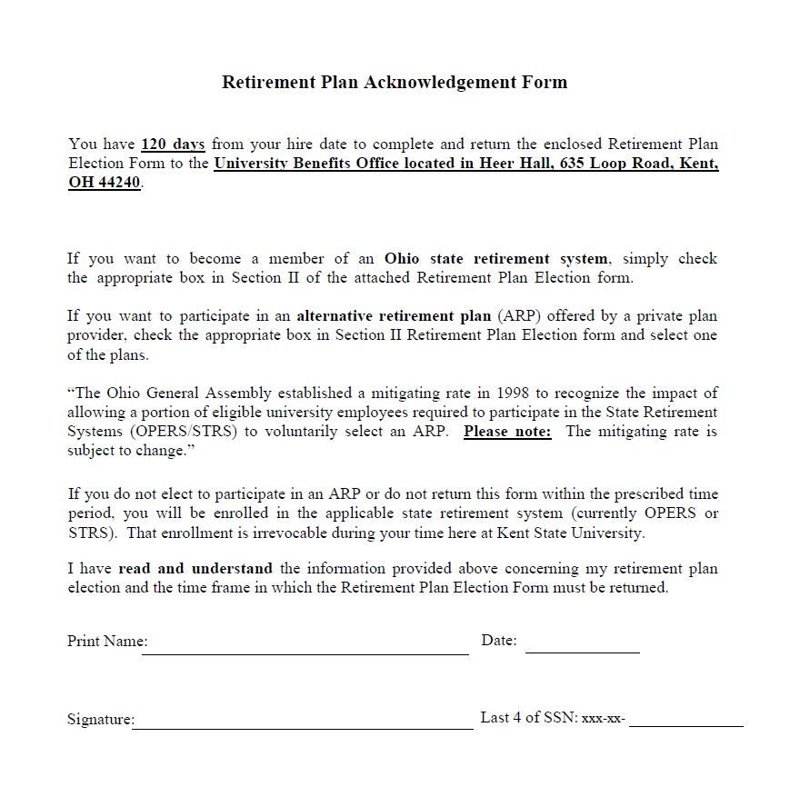
Due Today!
Sample

Slide 15
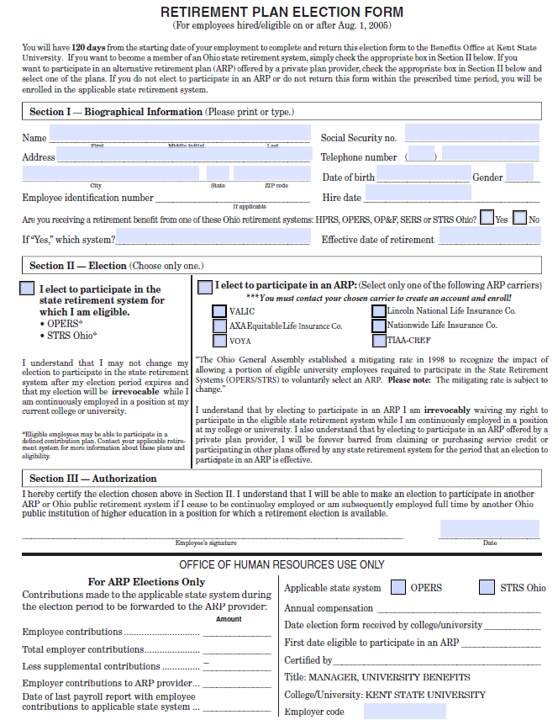
Due 120 days from hire date
Sample
http://www.kent.edu/hr/benefits/new-hire-benefits-information

Slide 16

Retirement Plan Options
Mandatory Retirement Contributions (State Retirement System)
Current state law gives a choice of retirement plans to full-time faculty, classified and unclassified employees in regard to their mandatory retirement contributions.
State Retirement System
OPERS (Ohio Public Employees Retirement System)
STRS (State Teachers Retirement System of Ohio)
ARP (Alternative Retirement Plan)
Elective Employee Contributions
403b/457b (Supplemental Retirement Savings)
http://www.kent.edu/hr/benefits/retirement

Slide 17
Comparing Your Options Under the
State Retirement System
OPERS | STRS
Traditional Pension Plan (OPERS invests for you) | Defined Benefit Plan (STRS invests for you)
Member-Directed Plan (You direct your investments) | Defined Contribution Plan (You direct your investments)
Combined Plan (You direct your contribution investments, OPERS directs KSU contributions) | Combined Plan (You direct your contribution investments, STRS directs KSU contributions)
Or | Or
Alternative Retirement Plan (ARP) | Alternative Retirement Plan (ARP)

Slide 18
OPERS Traditional Plan
STRS Defined Benefit Plan
You and the University contribute to this plan.
Benefit is determined by a formula using age, service credit and final average salary. (2.2% x Final avg sal x yrs of Svc)
Includes survivor, disability retirement benefits, at this time.
STRS Medical eligibility: Participants of the Defined Benefit Plan and Combined Plan who have 15 years of qualifying service credit qualify. If retiring retiring after August 1, 2023 or later – 20 years of qualifying services credit is needed.
The plan investment professionals manage the investment of employee and employer contributions and this plan bears investment risk.

Slide 19
OPERS Traditional
STRS Defined Benefit Option
OPERS |  | STRS
Contribution Rates |  | Contribution Rates
Employee KSU | 10.0% 14.0% 24.0% | Employee KSU | 14.0% 14.0% 28.0%
Vested: After 5 years of contributory services credit for Traditional Pension Plan |  | Vested: After 5 years of contributory services credit for Defined Benefit Plan

Slide 20
OPERS Member Directed Plan
STRS Defined Contribution Plan
You and the University contribute to this plan.
Retirement benefit is based on:
contributions,
investment performance and
payout option chosen at retirement
(e.g. lump sum, periodic, and annuity)
Employee controls investments and bears the market risk
To comply with the requirement of Section 145.87 of the Ohio Revised Code, the Board must take action to establish the “mitigating rate” for the Member-Directed and the Combined plans. This action is required because the Ohio Revised Code stipulates that a portion of the defined contribution plans’ employer contribution rate will be used for funding the defined benefit plan (Traditional Pension plan) to offset any negative financial impact due to the establishment of the new plans (Member-Directed plan and Combined plan). NOTE: Mitigating rates are subject to change.

Slide 21
OPERS Member Direct Plan
STRS Defined Contribution Plan
OPERS |  |  | STRS
Contribution Rates |  |  | Contribution Rates
Employee KSU | 10.0% 8.0% |  | Employee KSU | 14.0% 9.53%
4% Contrib. rate for Retiree Medical Account: (.5% Admin. Service Fee) KSU- |  | 4.5% | Contributions for mitigating rate: KSU- | 4.47%
Contributions for **mitigating rate: |  | 1.5% 24.0% |  | 28.0%
20% KSU match available after each year completed |  |  | 100% vested after 5 year of service
100% vested after 5 year of service
**To comply with the requirement of Section 145.87 of the Ohio Revised Code, the Board must take action to establish the “mitigating rate” for the
Member-Directed and the Combined plans. This action is required because the Ohio Revised Code stipulates that a portion of the defined contribution plans’ employer contribution rate will be used for funding the defined benefit plan (Traditional Pension plan) to offset any negative financial impact due to the establishment of the new plans (Member-Directed plan and Combined plan). NOTE: Mitigating rates are subject to change.

Slide 22
OPERS and STRS Combined Plan
OPERS |  | STRS
Contribution Rates |  | Contribution Rates
Employee KSU KSU – **Mitigating Rate | 10.0% 12.5% 1.5% | Employee (12% to DC) KSU | 14.0% 14.0%
Total | 24.0% | Total | 28.0%
100% vested after 5 years |  | 100% vested after 5 years
Medical benefits available after 20 years and age 60
**To comply with the requirement of Section 145.87 of the Ohio Revised Code, the Board must take action to establish the “mitigating rate” for the
Member-Directed and the Combined plans. This action is required because the Ohio Revised Code stipulates that a portion of the defined contribution plans’ employer contribution rate will be used for funding the defined benefit plan (Traditional Pension plan) to offset any negative financial impact due to the establishment of the new plans (Member-Directed plan and Combined plan). NOTE: Mitigating rate is subject to change.

Slide 23

What is the Ohio Alternative Retirement Plan?
The Ohio Alternative Retirement Plan or ARP is known as a 401(a) or a Defined Contribution Plan
Participants establish retirement accounts with vendors approved by the Ohio Department of Insurance
Who is eligible for an ARP? FULL-TIME employees
“The Ohio General Assembly established a mitigating rate in 1998 to recognize the impact of allowing a portion of eligible university employees required to participate in the State Retirement Systems (OPERS/STRS) to voluntarily select an ARP.” Please note: The mitigating rate is subject to change.
http://www.kent.edu/hr/benefits/state-and-alternative-retirement-options

Slide 24
Alternative Retirement Plan (ARP)
You and the University contribute to the plan
Benefits are based on your account balance
The account balance is equal to the sum of contributions plus investment gains/losses
You control the investment of your account balance and you accept all the risks of investment gains and losses
You are responsible for all Plan expenses
No survivor, retiree medical or disability benefits
“The Ohio General Assembly established a mitigating rate in 1998 to recognize the impact of allowing a portion of eligible university employees required to participate in the State Retirement Systems (OPERS/STRS) to voluntarily select an ARP.”
Please note: The mitigating rate is subject to change.
http://www.kent.edu/hr/benefits/state-and-alternative-retirement-options

Slide 25
Alternative Retirement Plan (ARP)
OPERS Eligible |  | STRS Eligible
Contribution Rates |  | Contribution Rates
Employee KSU | 10.00% 11.56% | Employee KSU | 14.0% 9.53%
Contributions for mitigating rate: | 2.44% | Contributions for mitigating rate: | 4.47%
Total | 24.0 % | Total | 28.0 %
All contributions are vested immediately |  | All contributions are vested immediately
“The Ohio General Assembly established a mitigating rate in 1998 to recognize the impact of allowing a portion of eligible university employees required to participate in the State Retirement Systems (OPERS/STRS) to voluntarily select an ARP.” Please note: The mitigating rate is subject to change.

Slide 26
Alternative Retirement Plan Providers
AIG/VALIC (Variable Annuity Life Insurance Co.)
AXA/Equitable Life Assurance Co.
VOYA (ING) Financial Services
Lincoln Financial Group
Nationwide Life Insurance Co.
TIAA/CREF

Slide 27

Social Security and Your State Retirement
Windfall Elimination Provision
Government Pension Offset

Slide 28
Summary Review
Retirement Plan Enrollment Process
Review your packet of information carefully
Make your decision and return your completed election form within the 120-day election period
Forms should be returned to the Benefits Office in the Heer Hall
You MUST complete a Retirement Plan Election Form regardless of your choice
Your Election is IRREVOCABLE once it is received in the Benefits Department for as long as you are employed by Kent State University

Slide 29
Retirement Resources
OPERS (www.opers.org) or 1-800-222-7377
STRS (www.strsoh.org) or 1-888-227-7877
ARP Providers (Contact information is included in packet)
KSU Benefits Coordinators

Slide 30

Supplemental Retirement Savings Options
Employees can elect to save additional amounts directly from their paycheck
2 options:
403(b) Plan
457(b) Deferred Compensation Plan

Slide 31
403(b) and 457 Deferred Compensation Plan
Employees can enroll anytime
Employees can change participation level anytime
Similar to 401(k) plans in private sector
Permit employees to save for retirement on a pre-tax (Traditional) or after-tax (Roth) basis
Annual contribution limits found in the IRS Code
Employee selects vendor and establishes account
Several vendors available to choose from
Employee must submit a salary reduction agreement

Slide 32
Annual Contribution Limits for
403(b) and 457 Plans
Year | Maximum Deferral Limits - Age 49 or less | Age 50 and over | Maximum Deferral Limits – Age 50
2017 | $18,000 | Addnl. $6,000 | $24,000

Slide 33
Understanding the Roth 403 (b)/457(b)
Traditional
Pretax contributions
Tax-deferred earnings
Taxable Withdrawals
Roth
After-tax contributions
Tax-deferred earnings
Tax-free Withdrawals*
* If withdrawn after the end of the five-year period beginning with the first year for which a Roth contribution was made to the plan, and after turning 59 ½, death or disability

Slide 34
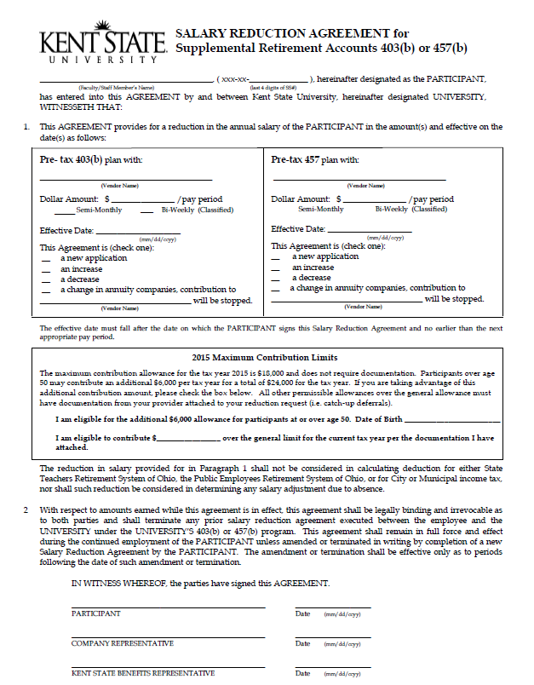
Sample

Slide 35
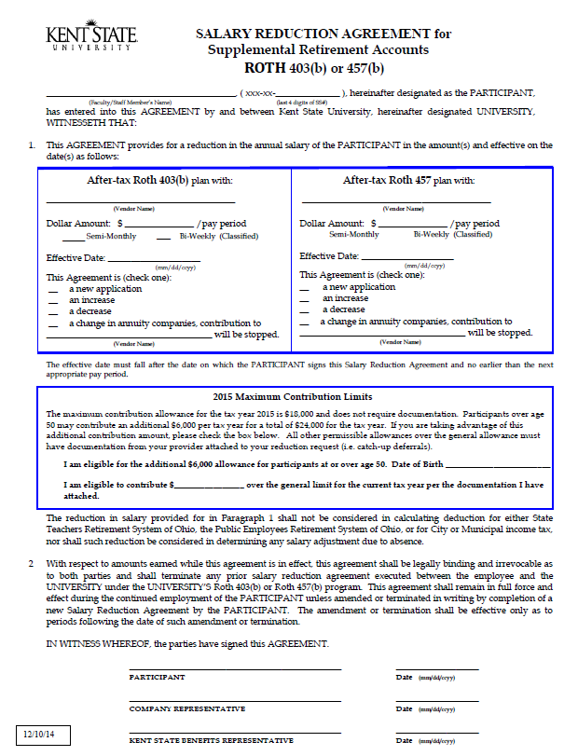
Sample

Slide 36

FAMILY MEDICAL LEAVE ACT
(FMLA) 1993
http://www.kent.edu/hr/benefits/family-medical-leave-fmla

Slide 37
Qualifying Reasons for FMLA Leave
Birth of a child and to care for the newborn child (bonding leave)
For placement with the employee of a son or daughter for adoption or foster care
To care for family member (spouse, son, daughter, or parent of the employee) with a serious health condition
Incapacity due to employee’s pregnancy, prenatal care, or childbirth
Employee’s serious health condition that renders employee unable to perform essential function of his or her position
Military Family Leave – Qualifying Exigency
Military Leave – Care for a Covered Service Member

Slide 38


Medical Plan Options
TRADITIONAL MEDICAL PLANS | 90/70 PPO (Medical Mutual & Anthem) | 80/60 PPO (Medical Mutual & Anthem)
Deductible | $250/single $500/family | $350/single $700/family
Co-insurance (after deductible) | 90%/70% | 80%/60%
Annual Out-Of Pocket Max. (Excluding deductibles) | $750/$1,500 | $900/$1,800
Office Co-pay | $15 – PCP/MH $30 - Specialist | $15 – PCP/MH $30 - Specialist
*PCP = Primary Care Physician
*MH = Mental Health Provider

Slide 39

Prescription Drug Coverage
Coverage is with CVS Caremark, Inc. – separate ID card
Provided with all plans
Retail – up to 30-day supply at local pharmacy
Mail service – up to 90-day supply through mail service pharmacy OR you can pick up mail order prescriptions at CVS! (**required for maintenance drugs after initial prescription and 2 retail refills)
Co-insurance is 10% for generic prescriptions and 20% for brand name prescriptions 40% for brand name when a generic is available.
$60 maximum per prescription EXCEPT when a brand name drug is purchased and there is a generic available, the maximum will be $100 unless the physician indicates “DAW” – dispense as written.

Slide 40


EyeMed Vision Care
Benefit | EyeMed
 | IN-NETWORK | OUT-OF-NETWORK
Standard Exam | Covered in full | Up to $90 reimbursement
Single, Bifocal and Trifocal vision lenses, frame and options | $240 with 20% discount on balance | Up to $240 reimbursement
Contact Lenses | Up to $190 | Up to $190 reimbursement
Frequency of benefit | Every 12 months

Slide 41

FlexSave Flexible Spending Account
Funds may be used for medical expenses not covered by insurance or other programs
Services must be performed while employee is contributing to the plan
“Use it or lose it” rule applies – However you have until March 15th of the following year to exhaust the previous year’s FSA funds
Flexible Spending Accounts (FSAs)
Health Care Account
Dependent Care Account
Funds may be used for dependent/elder care expenses
Why Participate?
Save 25%-40%
Deductible, Coinsurance, Co-Pay, OTC, Dental, Vision, etc.
Funds withheld from paycheck on pre-tax basis – maximum contribution: $2,500 Health Care Account, $5,000 Dependent Care Account per calendar year of IRC
NOTE: Minimum contribution is $120.

Slide 42
Sample

Slide 43
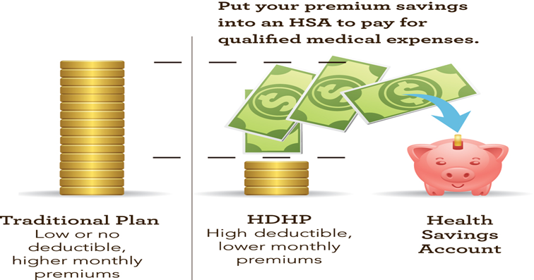
Traditional Health Plan vs High Deductible Health Plan

Slide 44
Medical Plan Options
HIGH DEDUCTIBLE PLAN | HDHP Anthem/Medical Mutual
Deductible (includes medical and prescription) | $2,600/Single $5,200/Family
Co-insurance | -0-
Annual Out-Of Pocket Max. | $2,600/Single $5,200/Family (*in-network)
Office Co-pay | 100% after deductible
Preventative Care (ie: asthma, diabetes, heart disease, smoking cessation) | 100% coverage with in-network providers for preventative care and preventative generic medications

Slide 45
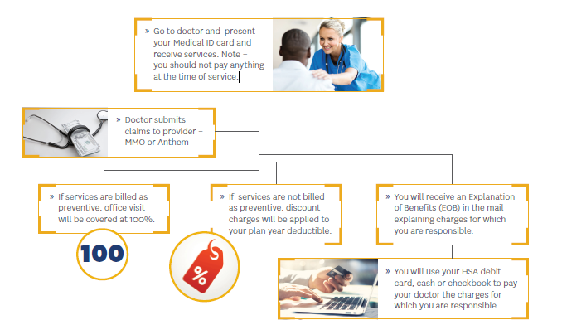
How does the HDHP work?

Slide 46

Health Savings Account (HSA)
Health Savings Account
Savings Account
High Deductible Insurance
Eligibility
Must be enrolled in a HDHP
Cannot be enrolled in a traditional healthcare insurance
Cannot be enrolled in Medicare
Cannot be claimed as a dependent on someone else’s tax return
Cannot be enrolled in a Health Care Flexible Spending Account
Enrollment Benefits
Savings to help pay your deductible and qualified medical expenses
Pre-tax savings
Tax deferred growth
Fully transportable

Slide 47
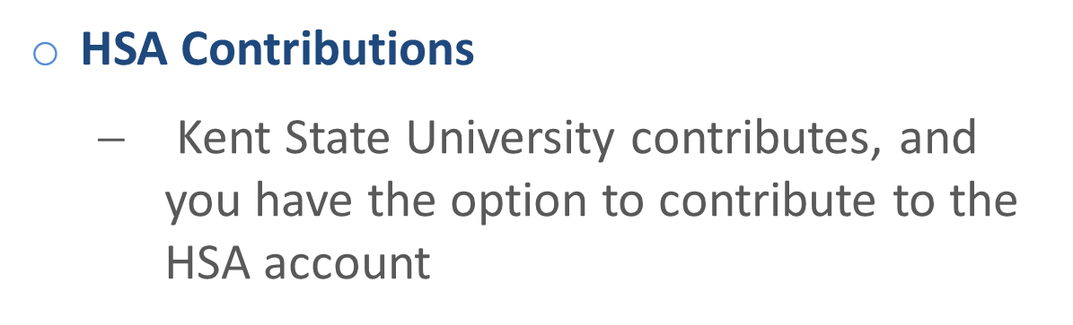
Coverage Level | KSU Contribution | Employee Contribution Limit | IRS Maximum Limit
Single | $1,000 | $2,400 | $3,400
Family | $2,000 | $4,750 | $6,750

Slide 48
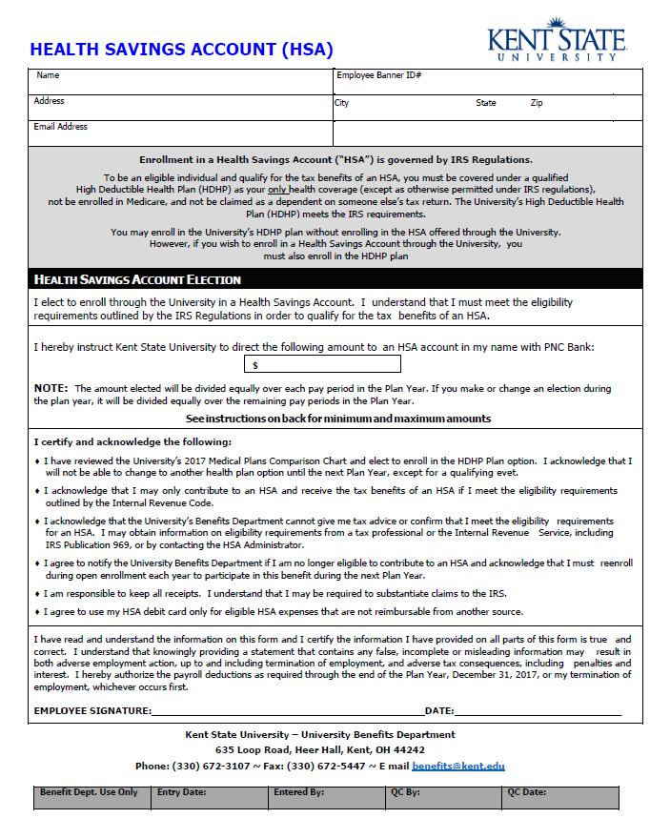


Slide 49
Creating a Personal Account with
Your Health Care Providers
Online Provider Director
Health Assessments
Discounts on Health Programs
Health Education
Access Recent Claims and Account Details
Treatment Cost Estimators
www.anthem.com | www.medmutual.com

Slide 50


Delta Dental
All plans may access any dentist
Best Benefit with a Delta PPO Network Doctor
Exams and cleanings – twice a year!
 | Delta Dental PPO HIGH | Delta Dental PPO BASIC | Delta Dental PPO LOW | AAUP Tenure & Non-Tenure Bargaining Unit
Annual maximum benefit per person / per yr | $1,250 | $1,000 | $750 | $1,250
Annual Deductible per person / per yr | $25 | $50 | $50 | $25
ORTHODONTIA *Services available for Network Drs. only | No age limit (PPO Dr. Only) ($1,000 limit - braces) | No age limit (PPO Dr. Only) ($1,000 limit - braces) | Not available | Age limit: 19 ($1,000 limit)
 | Age 19 (Premier Dr. Only) | Age 19 (Premier Dr. Only)

Slide 51
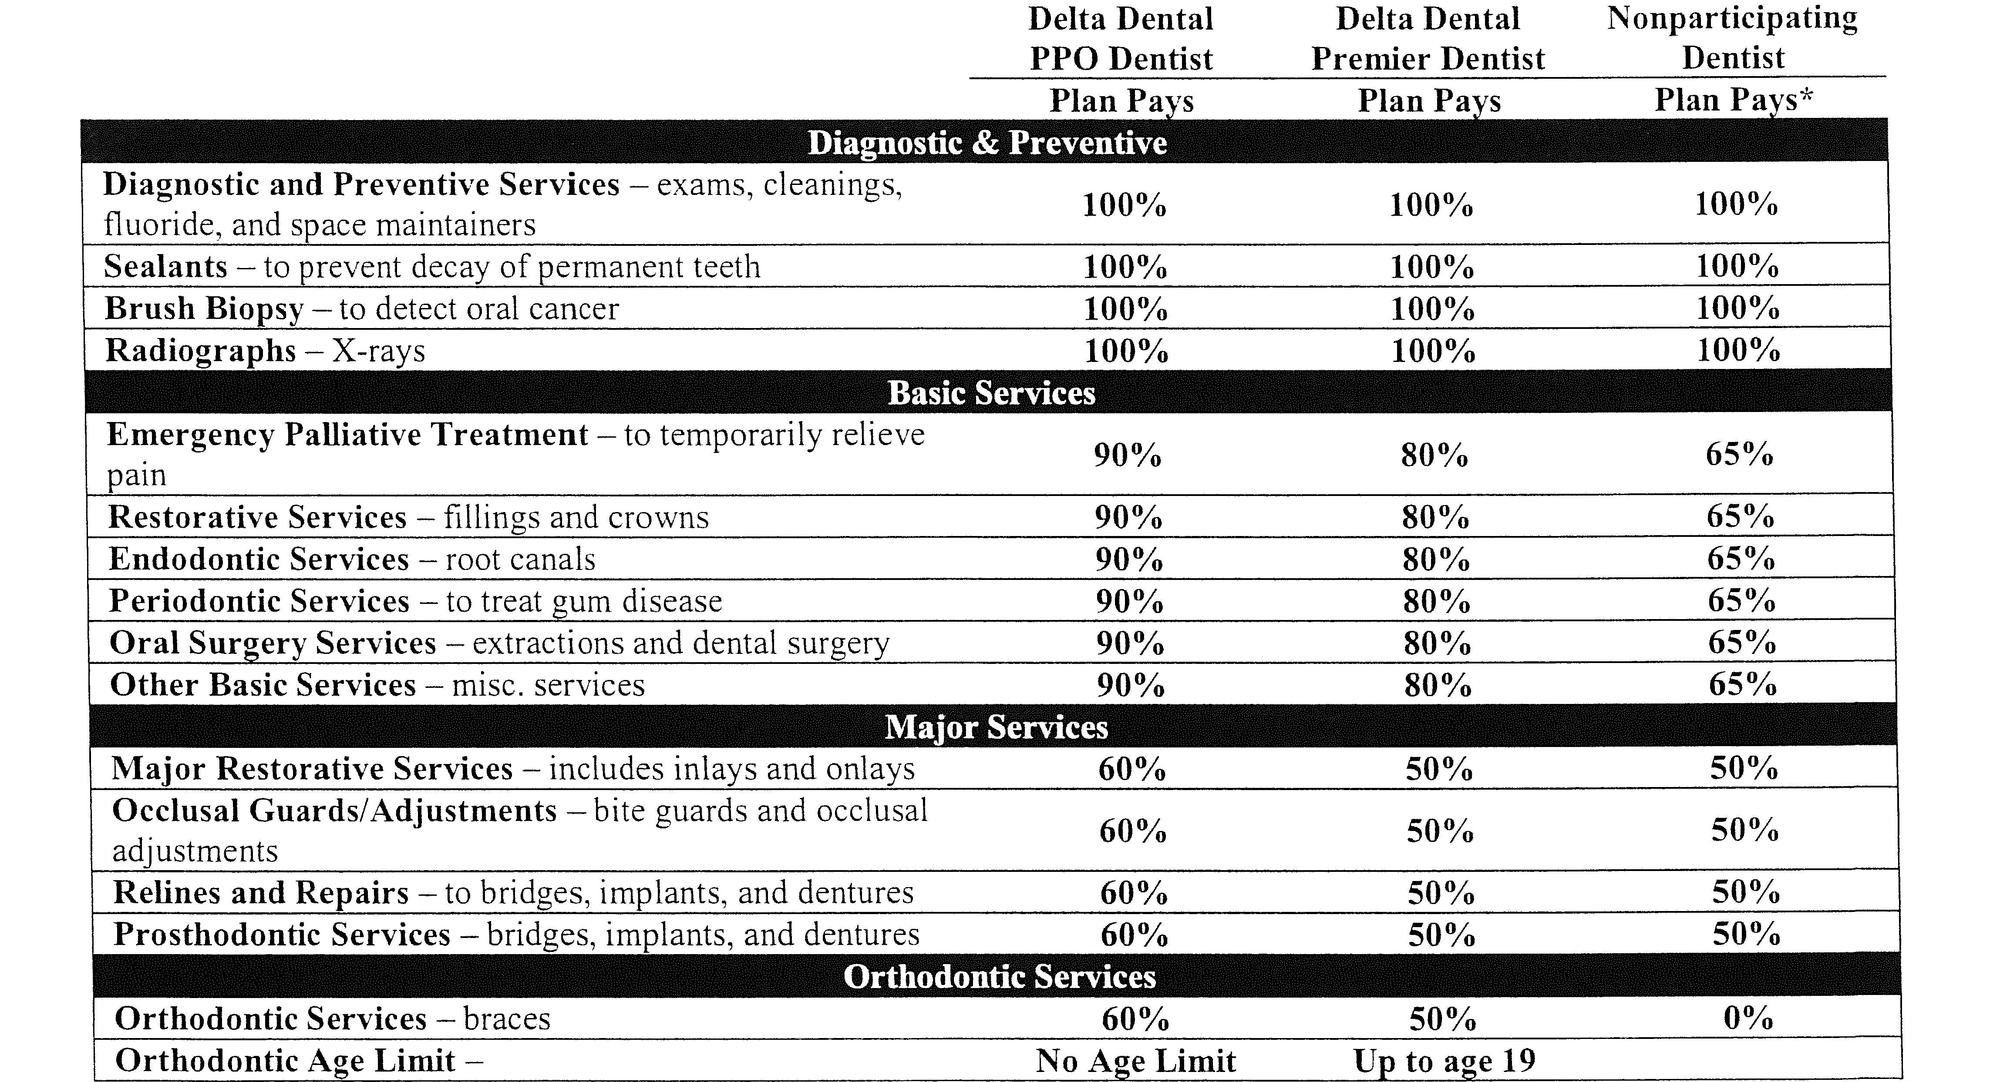
Delta Dental High Plan Summary
Diagnositc & Preventative
Basic Services
Major Services
Orthodontic

Slide 52
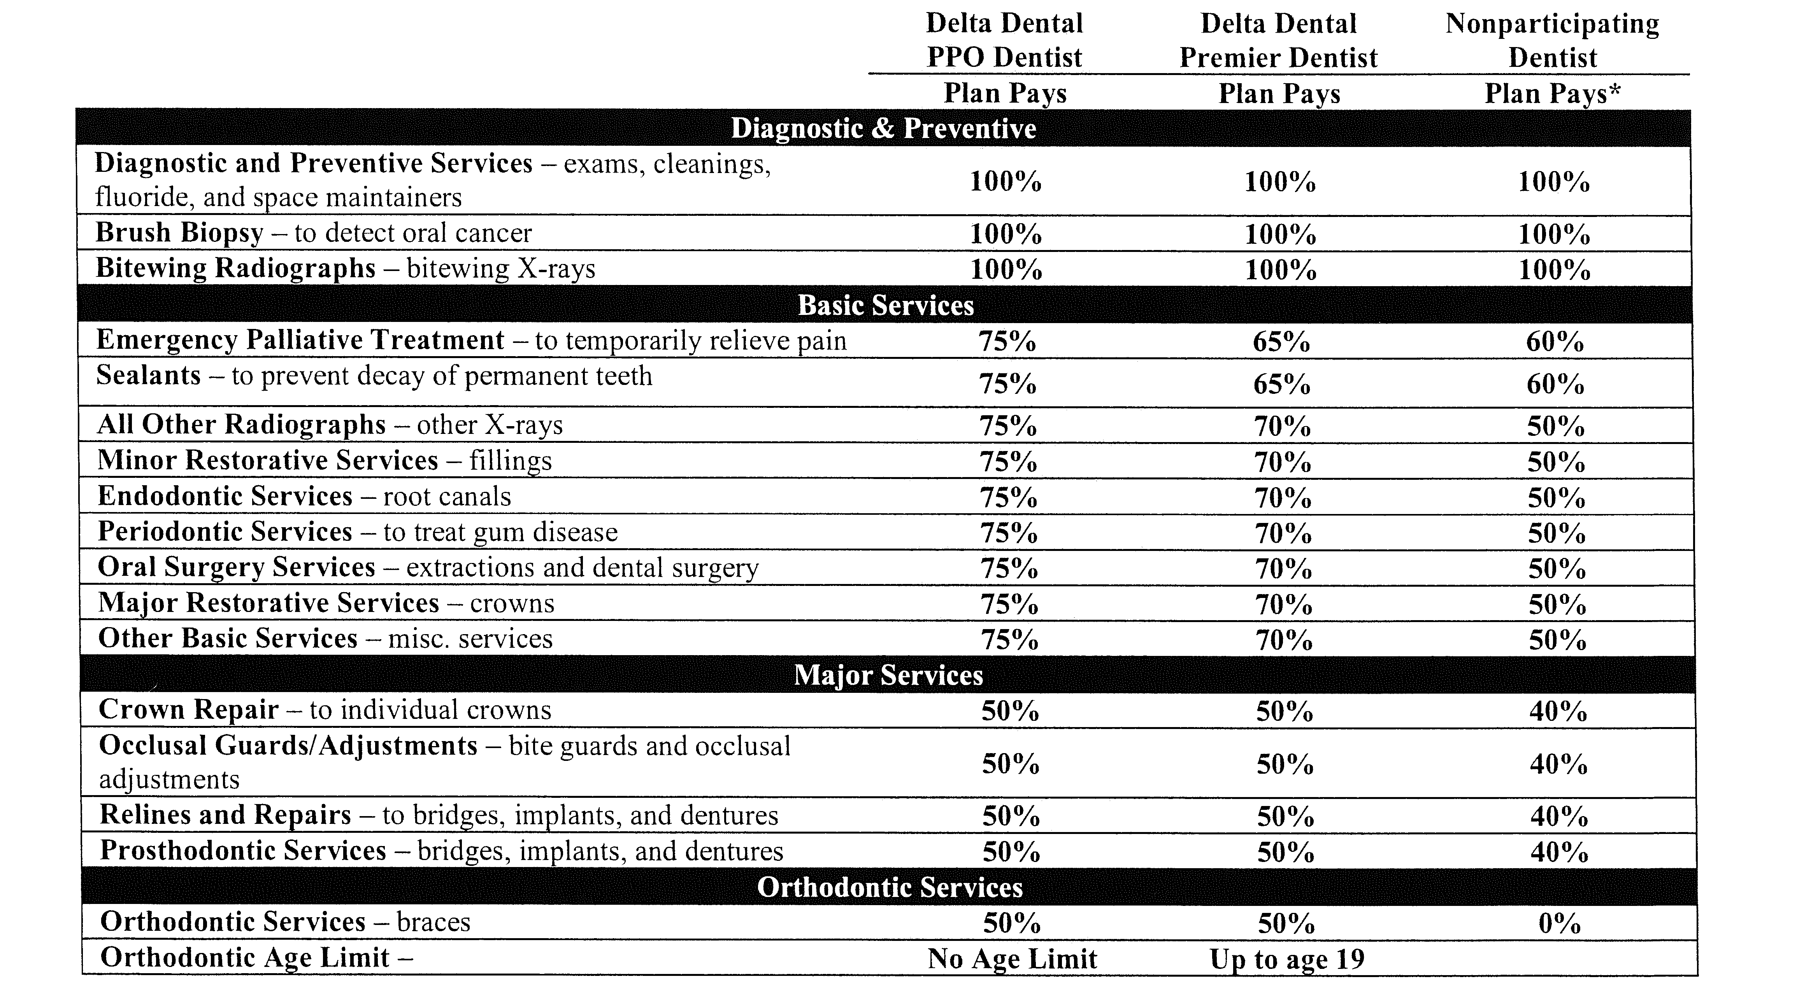
Delta Dental Basic Plan Summary
Diagnositc & Preventative
Basic Services
Major Services
Orthodontic

Slide 53
Delta Dental Low Plan Summary
Diagnositc & Preventative
Basic Services

Slide 54
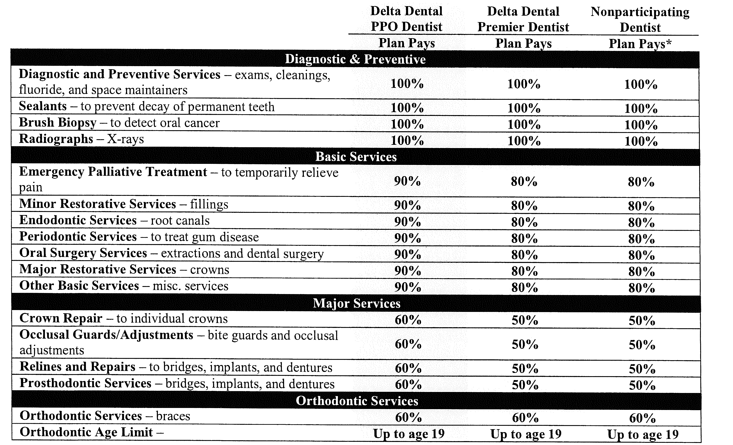
Delta Dental AAUP Plan Summary
Diagnositc & Preventative
Basic Services
Major Services
Orthodontic

Slide 55
Definition of Eligible Dependents
Listed below are the definitions of a dependent based upon the guidelines of Kent State University’s benefit plans.
Spouse: Your legal spouse.
Domestic Partner: The employee’s same or opposite gender registered domestic partner.
Child: A biological child, stepchild or adopted child of the employee or the employee’s spouse or registered domestic partner who is under the age of 26. A dependent child for whom the employee, the employee’s spouse or registered domestic partner has legal guardianship or legal custody.
Disabled Child: The maximum dependent age limits do not apply for a child who cannot hold a self- supporting job due to a permanent physical disability if:
The child becomes disabled prior to age 19 and remains disabled while covered under the medical plan(s).
The physical or mental impairment is a result of either a congenital or acquired illness or injury leading to the individual being incapable of independent living.

Slide 56
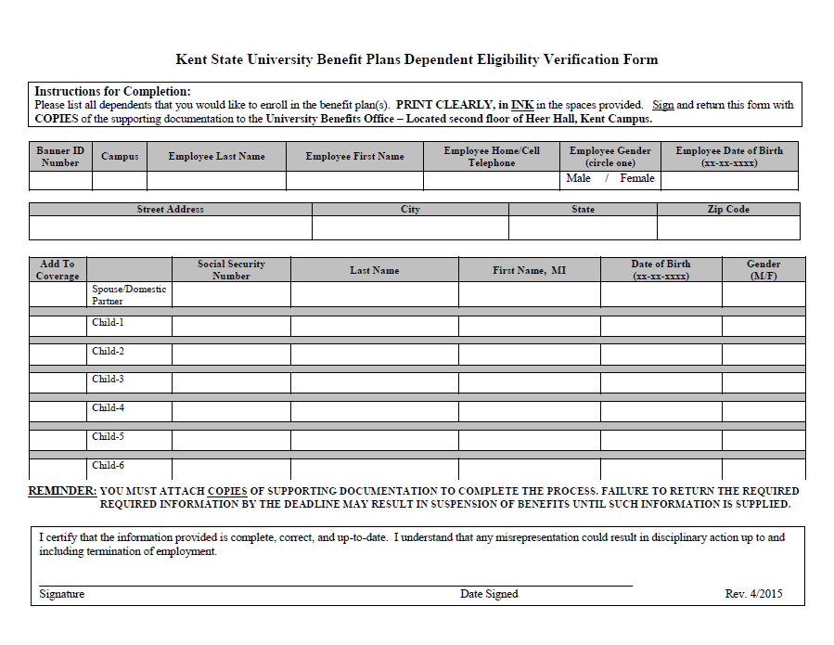
Due 30 days from hire
Sample

Slide 57
Domestic Partner Benefits
Kent State offers Domestic Partner benefits to eligible employees.
The benefits are extended to both same and opposite gender partners of faculty and staff and their eligible dependents which include:
Medical, prescription drugs, vision and dental insurance
Dependent life insurance
Voluntary Accidental Death and Dismemberment Insurance (AD&D)
Tuition Fee Waiver
Applicants must complete Affidavit of Domestic Partnership and provide (3) supporting documentations. Details regarding this process can be found on HR Benefits website at: www.kent.edu/hr/benefits

Slide 58
Let’s get it done in 31!
Avoid delays receiving your medical IDs

Slide 59
Alternative Insurance Coverage
“Opt-Out”
Employees with other coverage may opt-out of health coverage.
Must provide documentation of alternative coverage along with the completed Affidavit of Alternative Coverage form.
Opt-out incentive of $50.00 per pay equal to $100.00 month or $1,200.00 per year!
Opt-out applies to medical, prescription drug, vision AND dental.
This form can be found at http://www.kent.edu/hr/benefits/medical-insurance. Click on Opt-Out Affidavit in the middle of the page.

Slide 60
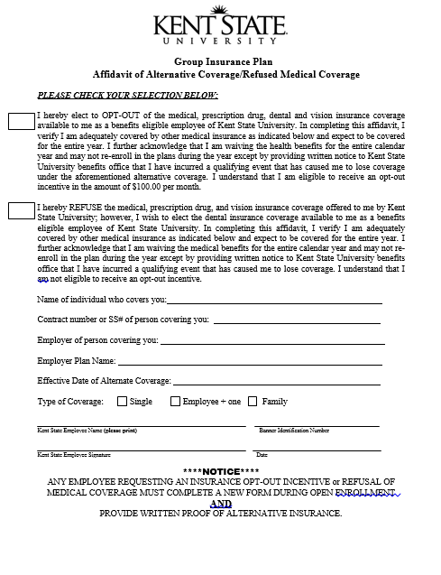
Sample

Slide 61

Group Term Life Insurance
AD&D Coverage
Employer-paid term life insurance for full-time employees provided by Standard Life Insurance Company
Coverage equal to 3 times base salary up to $225,000
Includes AD&D coverage
Employees must designate beneficiaries

Slide 62
Imputed Income for
Employer-provided Life Insurance
and
Voluntary Life Insurance
Internal Revenue Service (IRS) requires that the value of employer-provided life insurance and voluntary life insurance in EXCESS of $50,000 be reported as taxable income. This is called “imputed income”.
Imputed income is added to your taxable earnings. You can find the imputed income amount in Box 12 of your yearly W-2 statements.

Slide 63
Imputed Income - Example
TAXABLE INCOME PER $1,000 OF PROTECTION
Employee’s Age | Tax per $1,000
Under 25 | $.60
25 through 29 | .72
30 through 34 | .96
35 through 39 | 1.08
40 through 44 (John’s Age) | 1.20
45 through 49 | 1.80
50 through 54 | 2.76
55 through 59 | 5.16
60 through 64 | 7.92
65 through 69 | 13.44
70 and older | 24.72
John is 42 years old and earns $40,000 per year.
He is eligible for $120,000 (3 times his annual salary) of employer-paid basic group term life insurance.
The amount of taxable insurance is $70,000 ($120,000 minus $50,000).
For the employer-provided basic life insurance, the annual imputed income is $84.00
(70 X $1.20).
The $84.00 amount will be included on John’s W-2 (Box 12) statement as taxable income at the end of the year.

Slide 64

Voluntary Supplemental Plan Options

Slide 65
Voluntary Benefit
Supplemental Life Coverage Highlights
**Elections above the Guarantee Issue, must complete the medical questionnaire before approval.
Individual: Employee may elect up to 3 times base salary to a maximum of $500,000
*Guarantee Issue - $200,000
Spousal: Employee may elect coverage in increments of $10,000 up to a max of $250,000
*Guarantee Issue - $20,000.
Monthly premium cost for employee/spouse is based on age
Dependent: Employee may elect $10,000 per child at the cost of $1 per month (slightly higher for 9 and 10 month employees) no matter how many eligible children are in the family up to age 26.
NOTE: Spousal and Dependent’s life insurance cannot exceed 100% of an employee’s Basic Life and Additional Supplemental Life insurance.

Slide 66
Voluntary Benefit
Group Long Term Disability Insurance
A regular, full-time employee
Provides income protections in the event of a serious illness or injury
Premiums paid by payroll deduction
Employee can elect a benefit equal to 50% or 60% of salary to a maximum of $6,000/month
Enrollment accepted regardless of medical condition if submitted within 60 days of employment

Slide 67
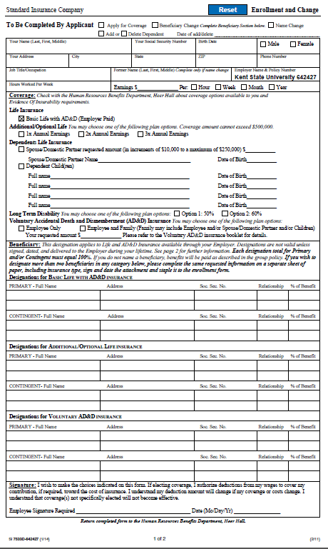
VERY IMPORTANT!
Sample

Slide 68

Aflac
PLAN OPTIONS
Short Term Disability
Accident Indemnity Advantage
Cancer Protection
Pays you cash benefits during time of need (accidents, sickness, surgery, maternity)
Guaranteed renewable for the life of the policy
Fully portable at the group rate
No coordination of benefits…”we pay regardless of any other insurance.”
Note: Some plans are only available during your first 60 days of employment and the annual Open Enrollment period. Other plans may be available year-round. Please contact Aflac for additional information.
Contact:
Derrick Fellows, 1544 South Belvoir Blvd., S. Euclid, OH 44141
(216) 382-9500;
derrick_fellows@us.aflac.com

Slide 69

Voluntary Benefit
College Advantage (529) Ohio Savings Plan
This is a college savings program that enables families to save and invest on a tax-advantaged basis to fund future higher education expenses of a child.
Enroll anytime.
Tax-Free: Pay no taxes as your funds grow and pay no taxes when you withdraw for qualified higher education expenses.
Available to anyone.
Account owners allocate funds.
Affordable contributions as little as $25 at a time.
CollegeAdvantage Savings Plan PO Box 932348
Cleveland, OH 44193
Phone: 1-800-AFFORD-IT (233-6734)

Slide 70
Voluntary Benefit
Legacy Services – Long Term Care Insurance
What is Long-Term Care?
Long-term care is the type of care you need when you are no longer able to do the things you take for granted everyday. It is needed when simple things, such as getting out of bed, eating, or even taking a shower, become too difficult to do on your own.
Why Consider Long-Term Care Insurance?
Long-term care insurance (LTCi) pays for home health care, assisted living, nursing home and other long term care expenses. People buy LTCi to protect retirement assets and to maintain freedom of choice when receiving care
Legacy Services
800-230-3398, ext. 101
email: custsvc@4groupltci.com
www.servilink.net/legacyltc

Slide 71

Tuition Waiver Benefit
Employees are eligible after completing one semester (or 120-days) of consecutive full-time employment
No “credit” for previous part-time or GA employment
Eligible dependents include legally married spouse and dependent children under the age 25 and domestic partners
Benefit covers tuition and general fees for up to 18 undergraduate hours per semester and 14 graduate hours per semester

Slide 72
IMPACT – Employee Assistance Program (EAP)
IMPACT Solutions is a behavioral healthcare and people development consulting firm for coaching and medical specialists.
24/7/365 Live, CONFIDENTIAL access to:
Immediate phone consultations
Face to face licensed counseling
Legal assistance
Financial counseling
Identity theft
Child and Elderly Care Referrals
Referrals to Community Resources
Accessible to you, your household members and eligible dependents living outside your home
Services provided for personal and work-related issues
Specialized assistance may be provided for financial matters, identity theft recovery and legal issues
1-800-227-6007 – 24 hours/7 days a week

Slide 73
Benefits Enrollment Timeline
Group Insurance Enrollment (Online – or hard copy) Medical, Prescription, Vision & Dental Coverage Opt-out affidavit (if applicable) *Domestic Partner Affidavit + Supporting Documentation Flexible Spending Accounts – HCFSA/DCFSA Life Insurance Beneficiary Designation Paper Form Required (Submit to H.R. Benefits Office) | 30 days from your Date of Hire or Benefits Eligibility
Long Term Disability Enrollment Form | 60 days
Retirement Plan Election Form | 120 days
Salary Reduction Agreement for 403(b) & 457 Tax Sheltered Annuities, College Advantage 529 Savings Plan, AFLAC Plans | Anytime
AFLAC Plans - Note: Some plans are only available during your first 60 days of employment and the annual Open Enrollment period. Other plans may be available year-round. Please contact Aflac for additional information.

Slide 74
Annual Open Enrollment
Annual opportunity to change elections relating to medical, prescription drug, vision, dental and flexible spending accounts
Conducted in Fall of each year – effective January 1st of the following year.
Watch your Flashline announcements, campus mailings and home mailings.

Slide 75
Questions??
If you have questions or need additional concerning your health insurance or retirement plan options, please feel free to contact:
Sheba N. Marshall, Assistant Manager, University Benefits | 330-672-8348 | smarsh22@kent.edu
Marianne Pickering, Coordinator, University Benefits | 330-672-8314 | mpickeri@kent.edu
Samantha Heald-Sott, Coordinator, University Benefits | 330-672-5861 | shealdso@kent.edu
Laura Kenney, Coordinator, Leave and Disability Benefits Programs | 330-672-8368 | lkenney2@kent.edu
Kimberly Hauge, Manager, University Wellness and Healthy Promotion | 330-672-7505 | khauge@kent.edu

Slide 76
Questions

Slide 77
DISCLAIMER
This Benefits Orientation presentation is provided as an informational summary only and is not intended to be a summary plan description (SPD) or plan document. If there are differences between the presentation and the SPD or plan document, the terms of the SPD and plan document shall be definitive.
Kent State University may amend or terminate its benefits plans at any time in accordance with the law and any applicable collective bargaining agreement. The description of the program, the plan itself, or participation in the plan is not an employment contract or any type of employment guarantee and should not be construed as such.
The university makes no endorsements, warranties, promises, representations and/or guarantees regarding the performance, use, interpretation, application, correctness, accuracy of any of the vendors’ plans and programs summarized in this orientation. Individuals should consult with the vendor(s) as well as their personal legal, medical, insurance and/or financial, etc., advisor/professional as it applies to their own circumstance to answer any questions and/or concerns related to their participation in the plan(s) and program(s).

